Slide 1
Contoso Currencies
<Leina Burton>
<leinaburton@gmail.com>
Notes:
Please enter project details and your details here.

Slide 2
It’s me!!
I have interests in video and tabletop games, social media
AUT Digital Design, game design project
Opportunities and meeting new people!
Time crunches ):
Expand skillsets, bring in interactivity to other media (art, comics, etc)
This section is NOT assessed. We just want to get to know you ☺.
Notes:
This section is NOT assessed. We just want to get to know you ☺.

Slide 3
User Experience
Quick and to the point
Simple commands
You can ask for ‘help’ at any time
Markdown formatting
Notes:
User Experience

Slide 4
Databases
EasyTables via MobileApp
Displays logs of previous exchanges made by the user
[Date of exchange, base currency, amount of base currency converted, what currency it was converted to, end result of currency conversion]
Notes:
Talk about your database, what schema you used and what data you used

Slide 5
API
Fixer.io global currency exchange
Easily accessible, covers a wide range of currencies
Select few common currencies used for prototype
Notes:
Advanced features…

Slide 6
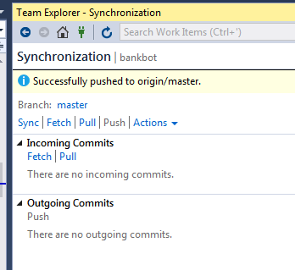
Azure Setup
Continuous deployment from GitHub:
The WebApp is deployed using a GitHub Source.
Using GitHub extensions for VS2015, changes are pushed to the GitHubt repo which is then deployed in real-time to Azure
Notes:
Explain your Azure features here

Slide 7

Advanced Considerations
Custom bank branding present in Card images and chatbot icon
For people who don’t want to open search engines or download apps for something as simple as currency exchange.
Notes:
Advanced considerations…

Slide 8
Final Comments
Potential integration with APIs such as stock exchange and geolocation
Would like to learn more specifically about Xamarin integration and LUIS
Notes:
Any final things you want to tell us

